Slide 1

SmartPlate
Automatic Number Plate Detection System — User Manual
Author: Ritvik Krishna Kodavati
Notes:
Preworks course home assignments

Slide 2
Table of Contents
Acknowledgements
About Me
About My Internship Journey with Clevered
About App
How do I use the App?
App Features & Options Breakdown
Contact Information

Slide 3
Acknowledgements
I would like to express my sincere gratitude to my mentors, Mr. Ken and Mr. Avishek Das for his guidance and support throughout this project.
A special thanks to my parents for their continuous encouragement.
I am also grateful to the open-source community behind OpenCV, PyTesseract, and CustomTkinter for providing the tools and documentation necessary to build this application.

Slide 4
About Me..
Hi! I am Ritvik
I love learning new things and interested in Computer Vision and Artificial Intelligence. Through this project, I aimed to solve real-world automation challenges by creating a user-friendly license plate recognition tool.

Slide 5
About My Internship Journey with Clevered..
During my internship with Clevered, I gained hands-on experience in Python programming, machine learning fundamentals, image processing, and UI development. Working under expert guidance allowed me to transform practical knowledge into a fully functional desktop application.

Slide 6
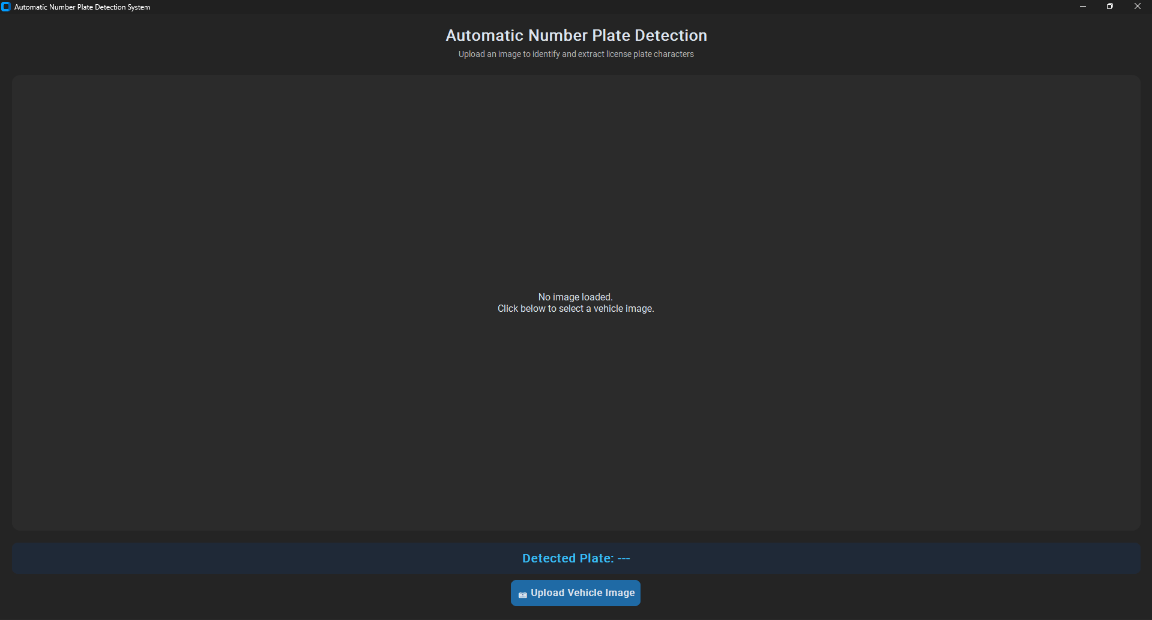
About App..
App’s Introduction
SmartPlate is an Automatic Number Plate Recognition (ANPR) desktop application designed to identify and extract license plate text from vehicle images automatically.
Features a modern CustomTkinter dark-mode interface with a dynamic image display card, a live detection status banner, and a single-click image uploader.

Slide 7
How do I use the App?
How do I use the App?
Launch Application: Open the Python executable or run python main.py in your terminal.
Select Image: Click on the "📷 Upload Vehicle Image" button.
Automatic Detection: The app runs image preprocessing (grayscale, noise filtering, contour detection) and extracts plate text using Tesseract OCR.
View Results: The original image displays with a green box around the plate, and the extracted text appears highlighted at the bottom.

Slide 8
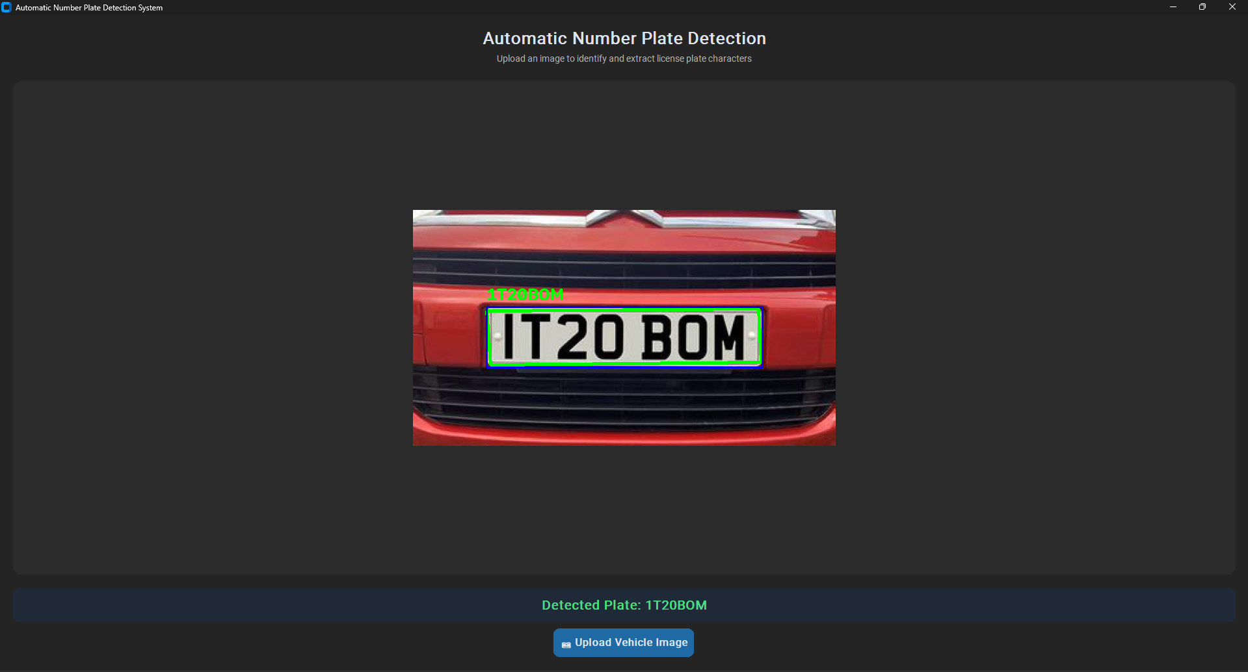
Upload image
.
Steps to Use:
Click "📷 Upload Vehicle Image".
Choose a .jpg, .jpeg, .png, or .bmp image from your system dialog.
View the bounding box drawn on the plate and read the recognized characters in the green banner.

Slide 9
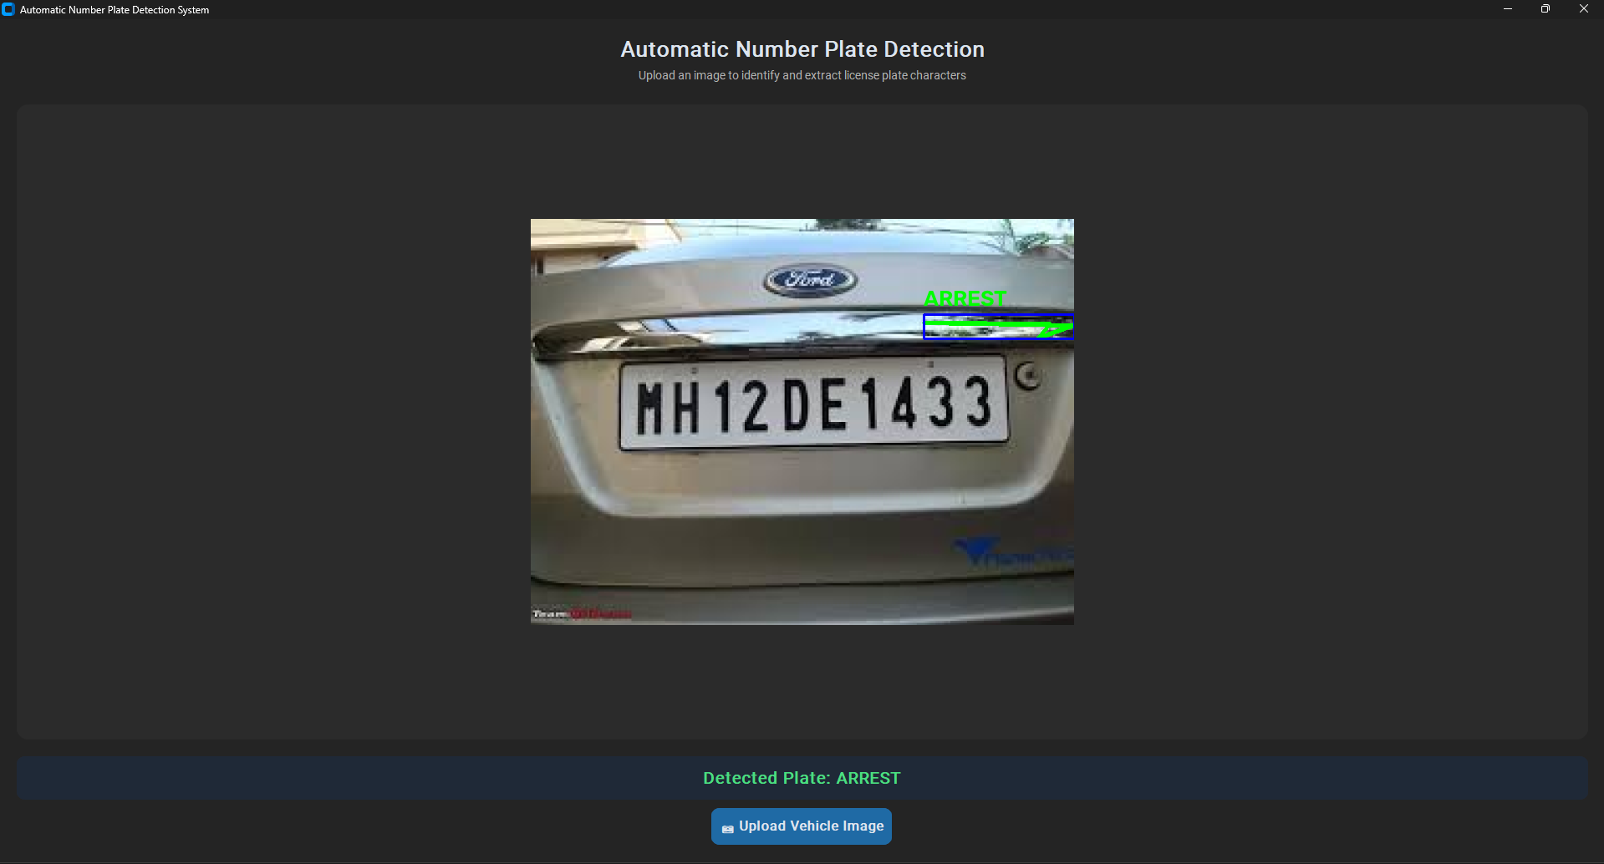
Image-2
.
Steps to Use:
Click "📷 Upload Vehicle Image".
Choose a .jpg, .jpeg, .png, or .bmp image from your system dialog.
View the bounding box drawn on the plate and read the recognized characters in the green banner.

Slide 10
Contact Person
Please reach out to Ritvik Krishna Kodavati at ritvik.krishna2009@gmail.com for any questions/ concerns/ suggestions on the App

Slide 11
Thank you!

